Slide 1
Lab 2-0
QCT SERVER
Parallel Programming
2024/09/26

Slide 2
System Spec
Slurm partition：qct-cpu
96 cores per node
2 threads per core
Maximum allocate node per job：1
MPI module：openmpi/4.1.6, mpi/latest

Slide 3
Slurm sbatch
#!/bin/bash
#SBATCH --job-name=my_job
#SBATCH --output=my_job_%j.out
#SBATCH --error=my_job_%j.err
#SBATCH --time=00:05:00
#SBATCH --nodes=1
#SBATCH --ntasks-per-node=2
#SBATCH --cpus-per-task=1

Slide 4
Lab 2-1
VScode SSH & SSH-key
Parallel Programming
2024/09/26

Slide 5
Generate SSH key
On your computer：
ssh-keygen -t rsa -b 4096
cat ~/.ssh/id_rsa.pub
On the remote server：
mkdir ~/.ssh
vim ~/.ssh/authorized_keys
copy it
paste the key into it

Slide 6

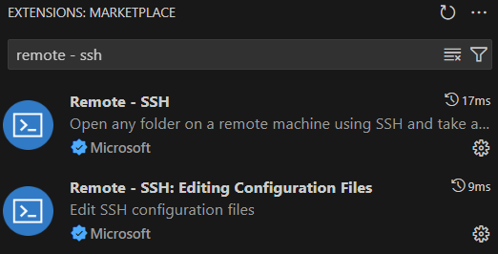
VScode SSH-Config
Extension Marketplace
Go to extension marketplace
Install both of them
Go to remote explorer
Open SSH Config File
Remote Explorer

Slide 7
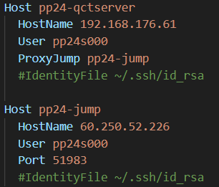
VScode SSH-Config
Host：An alias use to refer to this server
HostName：IP address of the target server
User：Username
ProxyJump：Tells SSH to use the another host as an jump server
IdentityFile：The private key file to use for authentication
Port：Port to connect the target server
After setting up, Ctrl+S and refresh

Slide 8
VScode SSH-Config
如果你是用前面簡報的方式設定，
請將你本地的public key複製到跳板機以及QCT server。
如果你是先連線到跳板機再連線到QCT server，
跳板機上要放本地的public key以外，要再生成一個key，
並將這個key放到QCT server。
或是你也可以打密碼就好

Slide 9
Lab 2-2
Pthread & OpenMP
Parallel Programming
2024/09/26

Slide 10
Linking Pthread & Openmp
Linking pthread gcc your_program.c -o your_program -pthread
Linking openmp gcc your_program.c -o your_program -fopenmp
Linking both gcc your_program.c -o your_program -pthread -fopenmp

Slide 11

Approximate pixels
Copy source file to your home directory：cp -r /home/share/lab2 ~/
lab2 judges：lab2_pthread-judge lab2_omp-judge lab2_hybrid-judge

Slide 12
Approximate pixels using pthread and OpenMP
Modify the sequential code lab2_pthread.cc with pthread
g++ lab2_pthread.cc -o lab2_pthread -pthread -lm
srun -c4 -n1 ./lab2_pthread ? ?
Modify the sequential code lab2_openmp.cc with openmp
g++ lab2_openmp.cc -o lab2_openmp -fopenmp -lm
srun -c4 -n1 ./lab2_openmp ? ?

Slide 13
Approximate pixels using Hybrid MPI with OpenMP
Modify the sequential code lab2_hybrid.cc with MPI and OpenMP
mpicxx lab2_hybrid.cc -o lab2_hybrid -fopenmp -lm
srun -n6 -c4 ./lab2_hybrid ? ?

Slide 14
Lab 2-3
Vectorization
Parallel Programming
2024/09/26

Slide 15
SISD
Instruction Pool
Data
Pool
PU

Slide 16
SIMD
Instruction Pool
Data
Pool
PU
PU
PU
PU

Slide 17
Vector Instruction Set
lscpu can be used to display the vector instruction sets supported by the CPU
On the QCT server, sse/sse2/avx/avx2/avx512 and more are available.

Slide 18
Vector Instruction Set
SSE（Streaming SIMD Extensions）
128-bit registers, doubling the width of the 64-bit MMX registers
SSE only supports 32-bit floating point
SSE2 adds double, long long, int, char

Slide 19
Vector Instruction Set
AVX（Advanced Vector Extensions）
Expanded SIMD registers from 128 bits (in SSE) to 256 bits
Supports both single-precision and double-precision floating-point operations
AVX512 expands SIMD registers to 512 bits

Slide 20
Vector Instruction Set
Codes have to be executed many times, will probably benefit from vectorization
If there are no data dependency, it will be easier to vectorize
Data dependency means the value of one data elements depends on another

Slide 21
Automatic Vectorization
GCC Vectorization
-ftree-vectorize：enabled vectorization
-O3：enabled vectorization by default
-march=native：use instructions supported by the local CPU
-fopt-info-vec-all：print vectorization log
#pragma GCC ivdep：tells compiler there is no data dependency in the following loop

Slide 22
Intel Intrinsics
Allows developers to use advanced instruction sets of processors directly in C/C++
Procedure：
Load data from memory to the special registers
Perform vector instructions
Save data from the special registers to memory

Slide 23
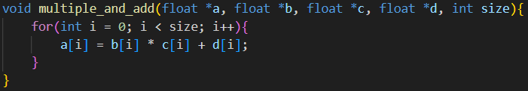
Intel Intrinsics
Compile sample code：
g++ -o vectorize_example vectorize_example.cc -march=native
Original

Slide 24
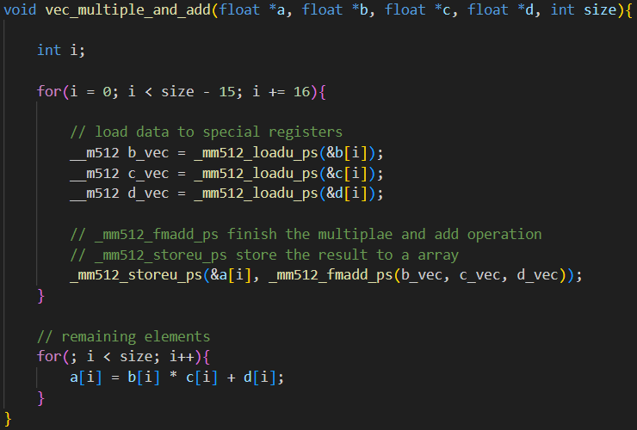
Intel Intrinsics

Slide 25
Lab 2-4
Profiling
Parallel Programming
2024/09/26

Slide 26
Intel Vtune
module load intel-vtune/2024
Vtune command line syntax introduction：link
vtune -h
vtune -collect hotspots -result-dir $HOME/vtune-result ./vectorize_example
mpirun -n 2 vtune -collect hotspots -result-dir $HOME/vtune-result ./vectorize_example

Slide 27
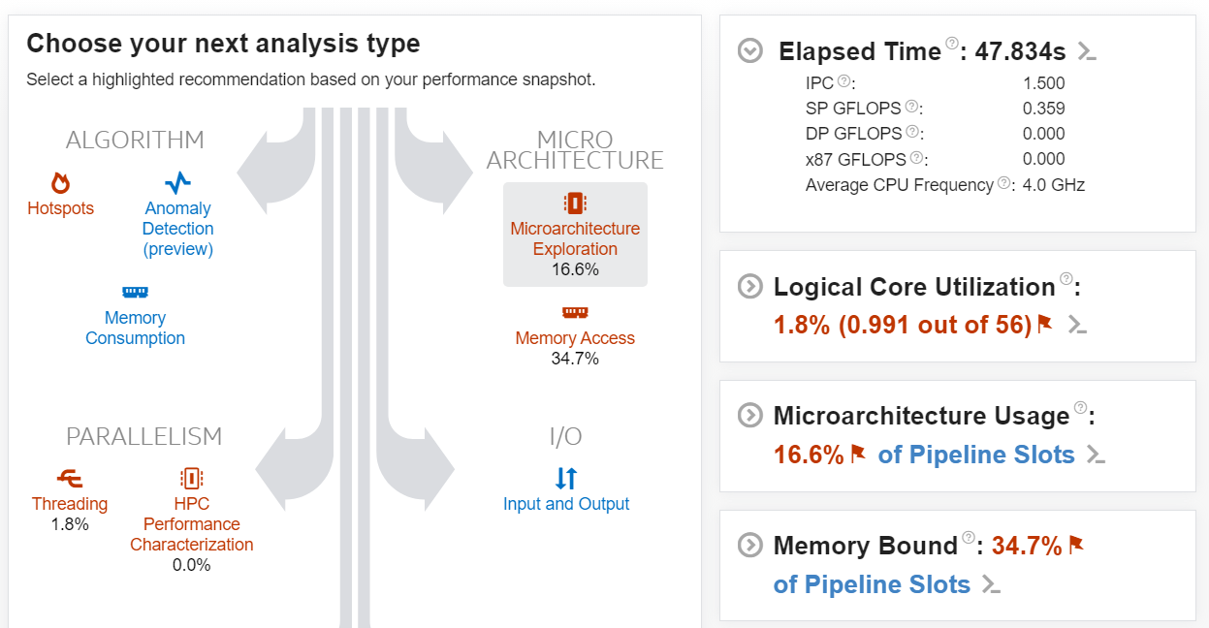


Intel Vtune
Install it on your computer：link
Find this：
Choose your .vtune file and open it
performance-snapshot
hotsots

Slide 28
HW2
Parallel Programming
2024/09/26

Slide 29
SPEC

